Slide 1
Move To
Functional Programming

Slide 2
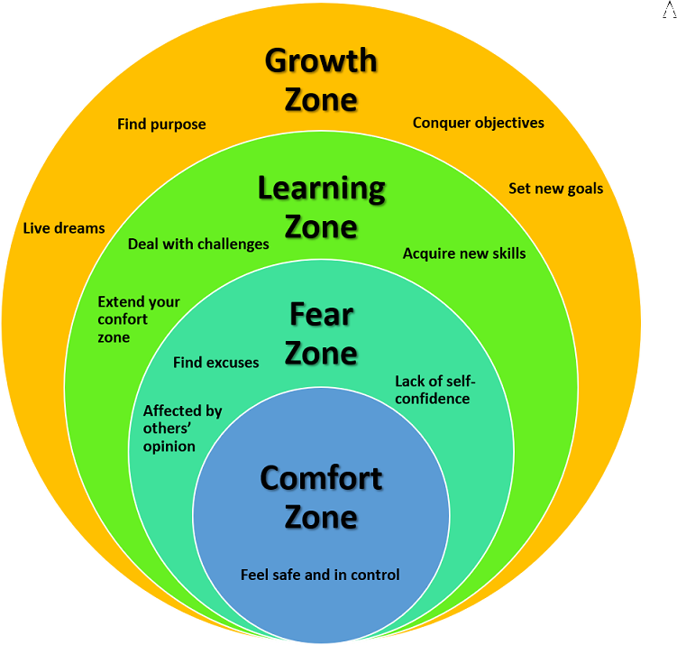
Move to functional
Are you safe and in control?

Slide 3
Move to functional
Agenda
Why?
Theory
Patterns
Snippets

Slide 4
Why?
Functional programming

Slide 5
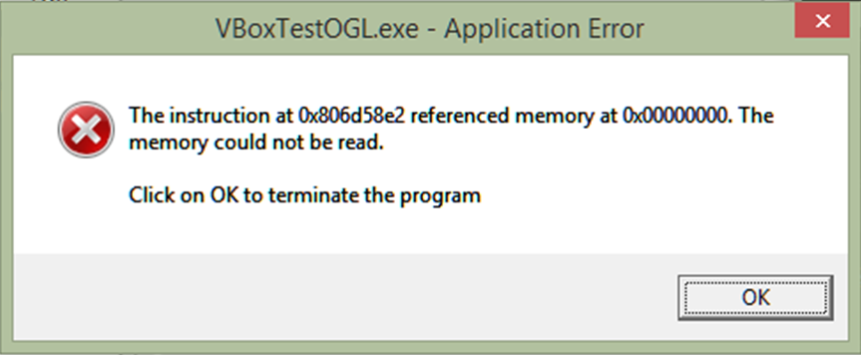
Move to functional
Why? The billion dollar mistake
NULL
Tony Hoare invented the null reference in 1965
NULL, null, Nothing, nil, nullptr, undef, undefined, None, …
Client must check ALWAYS the return value …
… to avoid null reference exception

Slide 6
Move to functional
Why? How much I love them… ☹
IF and SWITCH
Cyclomatic complexity is a software metric, used to indicate the complexity of a program.
It is a quantitative measure of the number of linearly independent paths through a program's source code.

Slide 7
Move to functional
Why? Clean and Beautiful code
Readability
Composition of functions let your code be fluent
Without IF and with fluent programming the code is more declarative so it’s more readable
The code is more beautiful and so it works by definition

Slide 8
Theory
Functional programming

Slide 9
Move to functional
Functional programming languages
Functions are first class citizen
You can assign a function to a variable
You can pass a function as a parameter of another function
You can return a function as a result of another function
High Order Functions

Slide 10
Move to functional
Immutability
Avoiding state mutation and shared state
Function “must” be pure
Deterministic
No side effect
Mutate global state, Mutates input arguments, Throw exception, Perform any I/O operation
No race condition
Referential transparency
Function “must” be sincere (do what it says)

Slide 11
Move to functional
Paradigm
The imperative approach follows the principle of workflow control and answers the question ‘how to do’
The declarative approach describes the data flow and answers the question ‘what to do’

Slide 12
Move to functional
Unit instead Void
Modelling the absence of data
Void has a lot of problem because the compiler treat it as special value and we cannot write something like Func<Void>
The use of void in the functions means we have function with side effect because they don’t return anything
Unit is a type to represent the absence of data
Using Unit we can convert all the Action function into Func<Unit>
Every functions should return a value and void is a type with zero values

Slide 13
Move to functional
Datatypes
A datatype is a an abstraction that encapsulates one reusable coding pattern
These datatypes are generalised by having one or several generic parameter
Usually a data type is implemented by a struct to be immutable

Slide 14
Move to functional
Option<T>
Option<T> is a datatype that represents absence
It is like a box containing or not the value
You can access the internal value using a Match function taking two parameters:
The Some call back in case of value is present
The None call back in case of value is not present

Slide 15
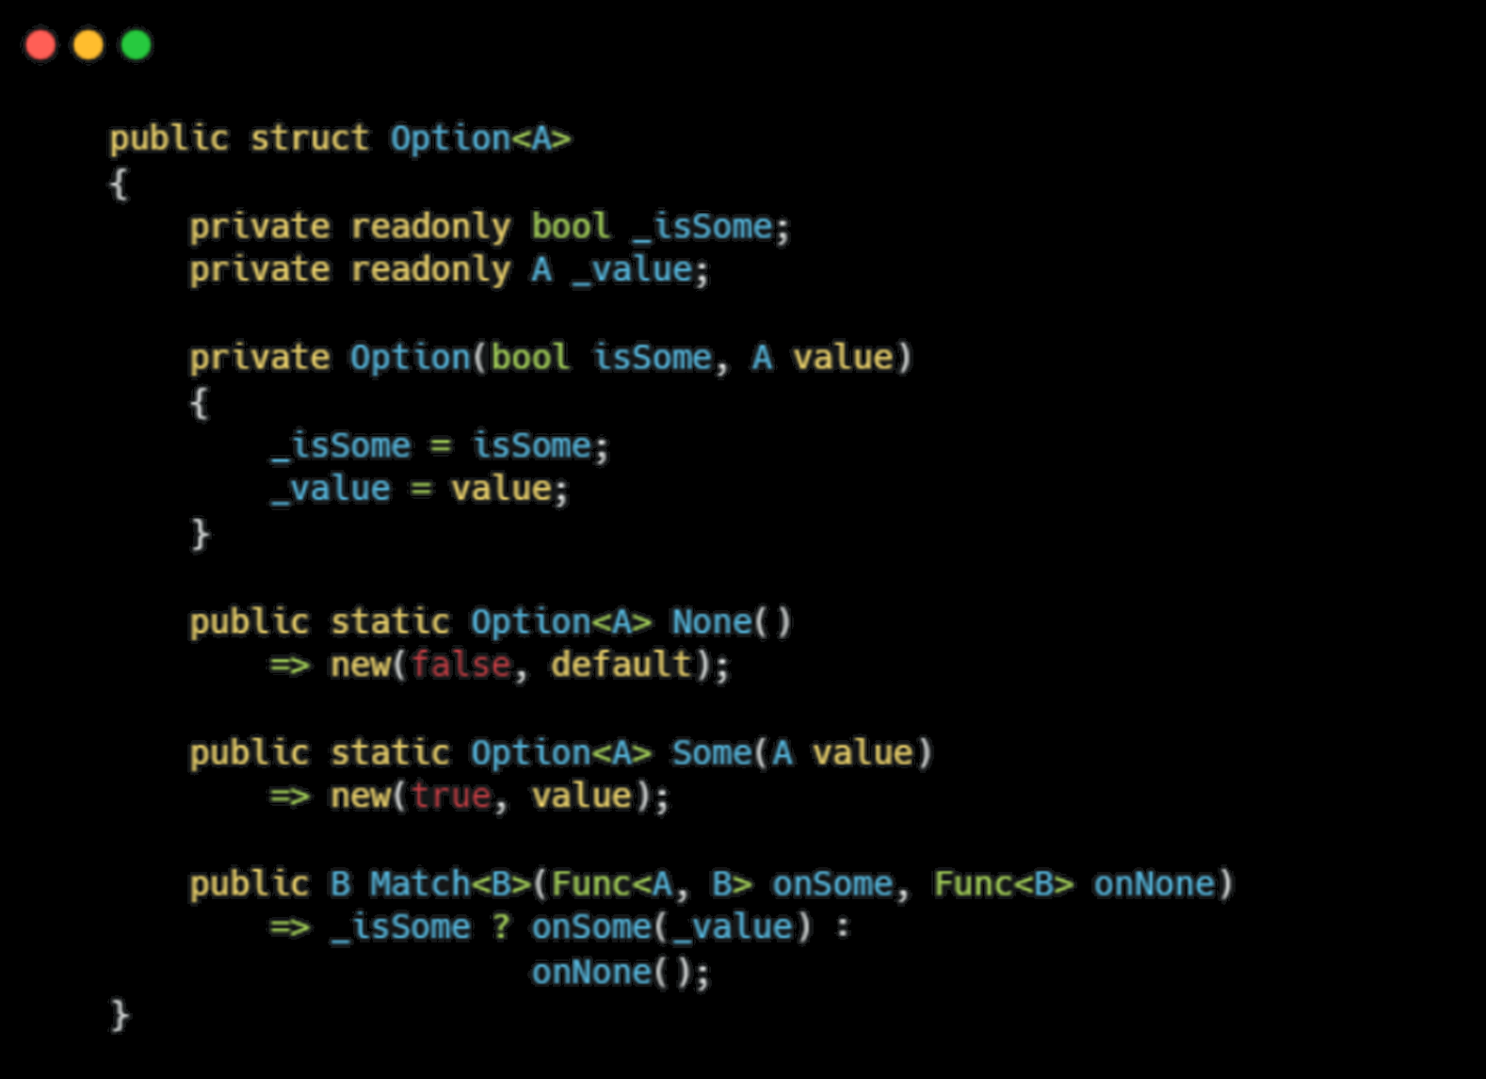
Move to functional
Option<T>

Slide 16
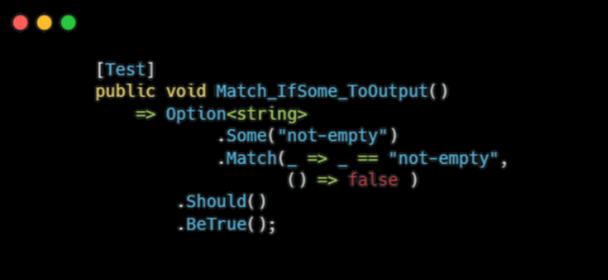
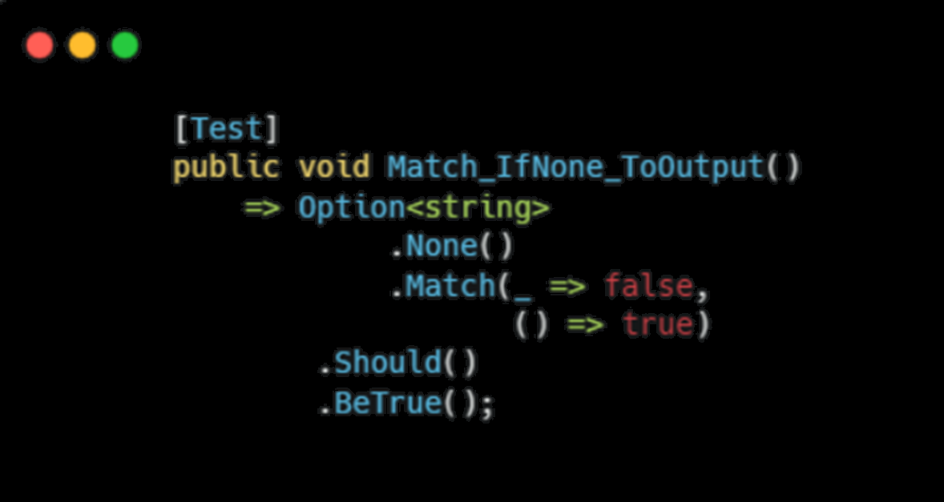
Move to functional
Option<T>

Slide 17
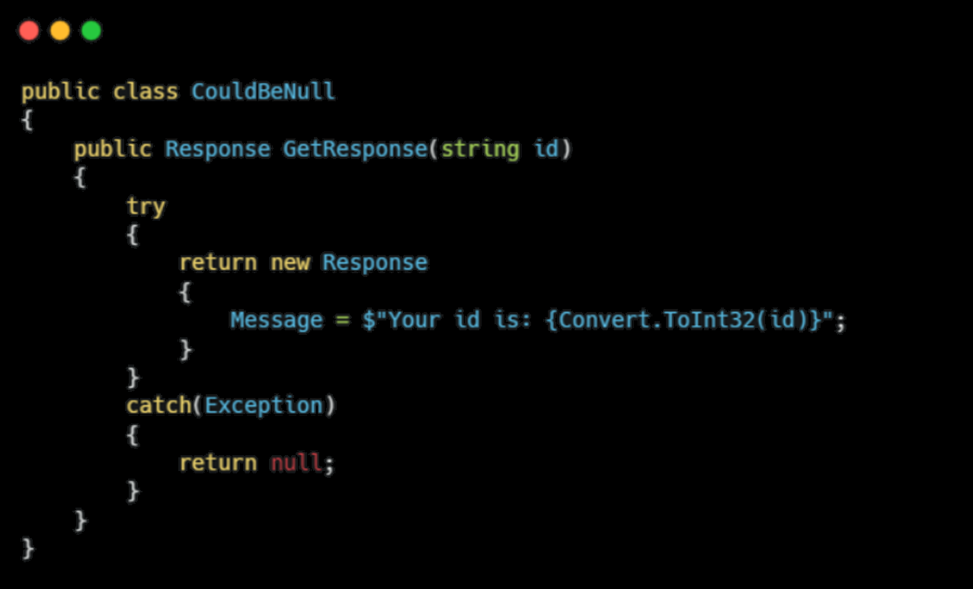
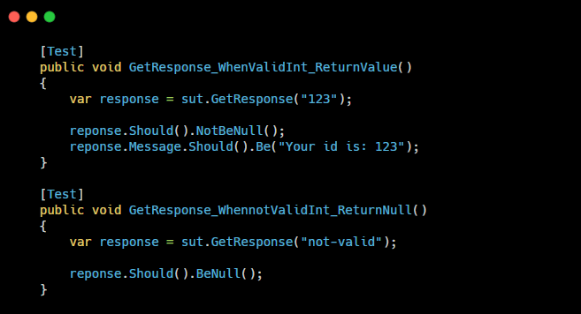
Move to functional
Option<T> … use case
Code is not safe, we have to check for NULL value

Slide 18
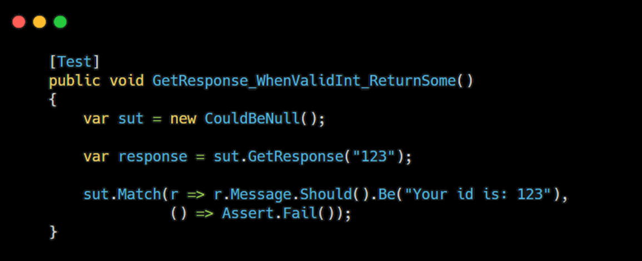
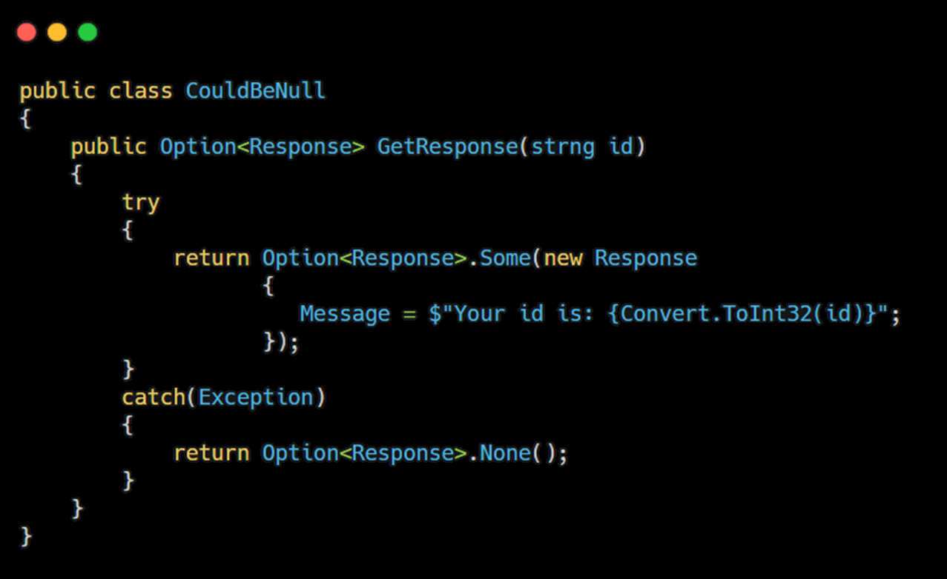
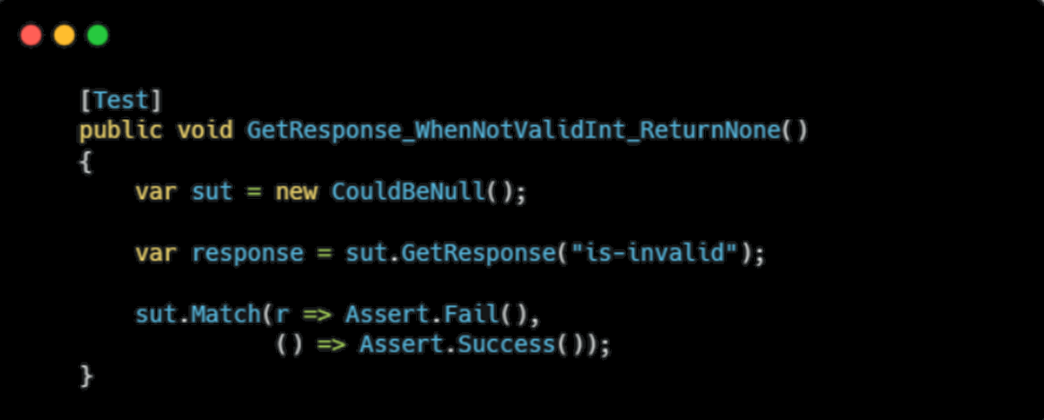
Move to functional
Option<T> … much better
Code is safe by design, no NULL to check

Slide 19
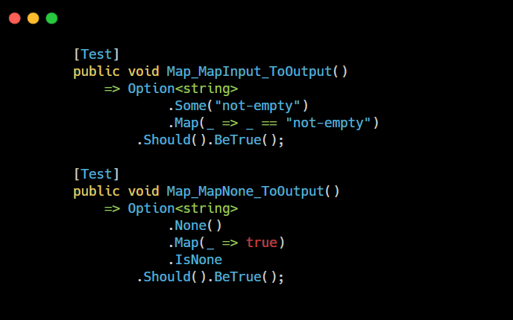
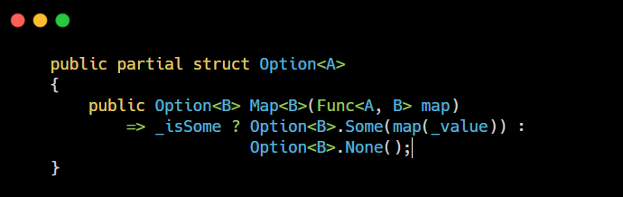
Move to functional
Option<T> … function concatenation Map

Slide 20
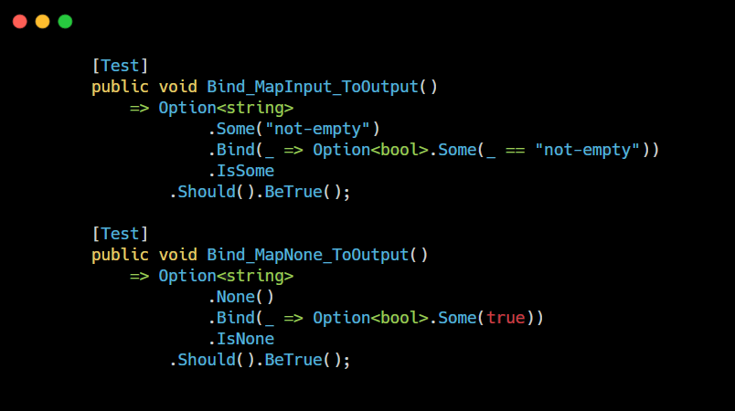
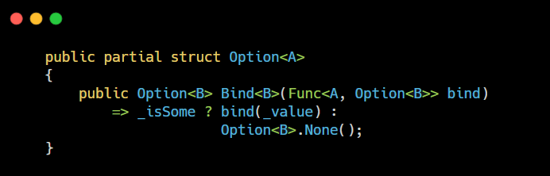
Move to functional
Option<T> … function concatenation Bind

Slide 21
Move to functional
Either<L, R>
In the day by day work functions can fail, so we have to handle the errors
Either allows us to define two possible return values for a function
The Right value is case of success
The Left value in case of error

Slide 22
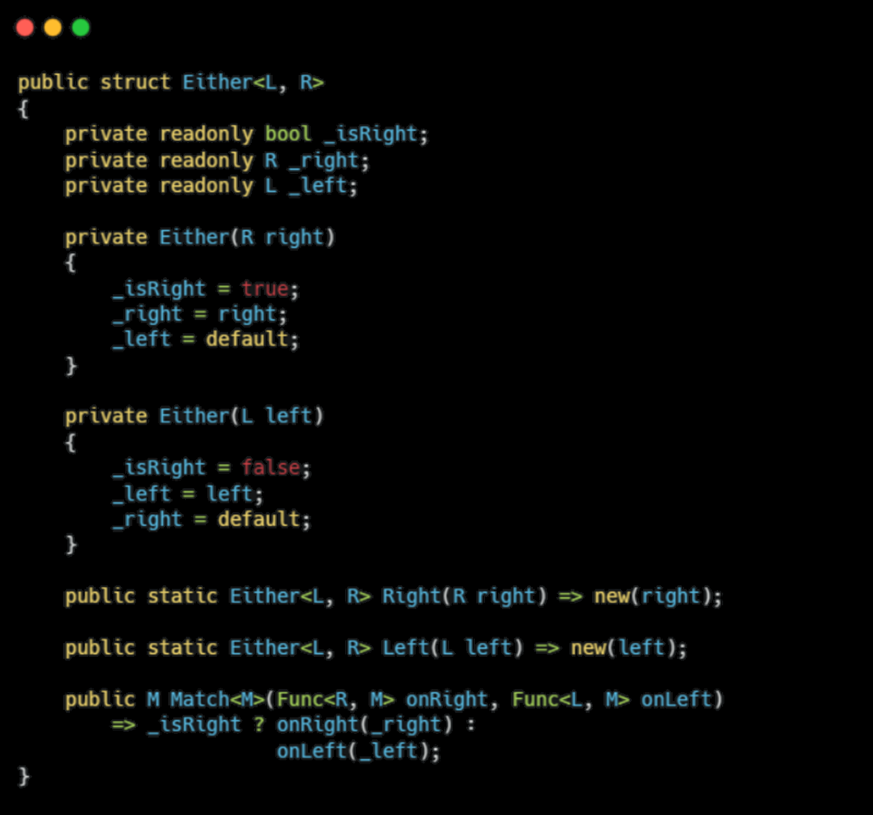
Move to functional
Either<L, R>

Slide 23
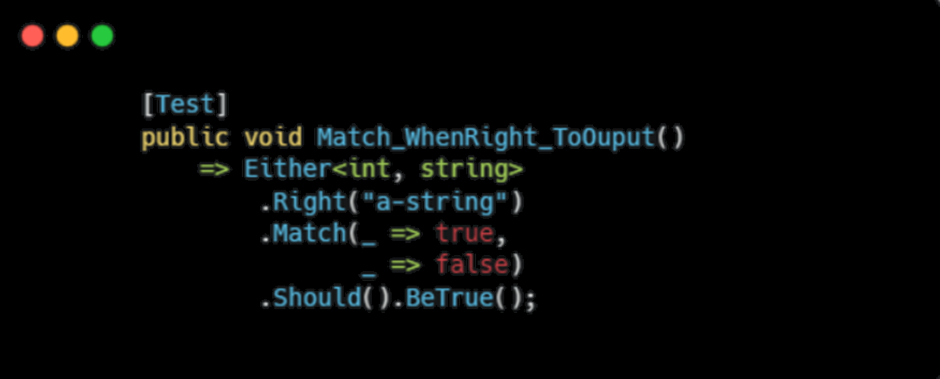
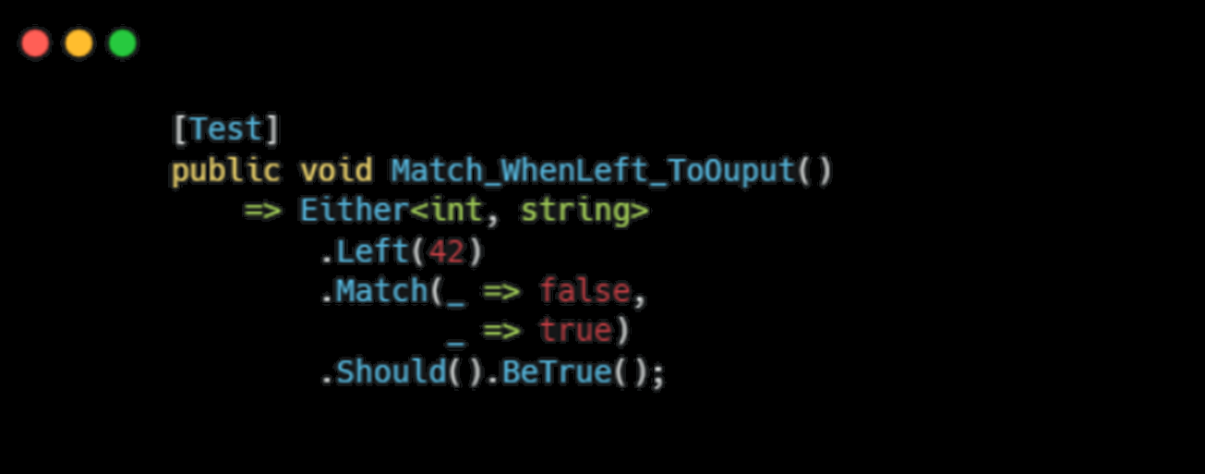
Move to functional
Either<L, R>

Slide 24
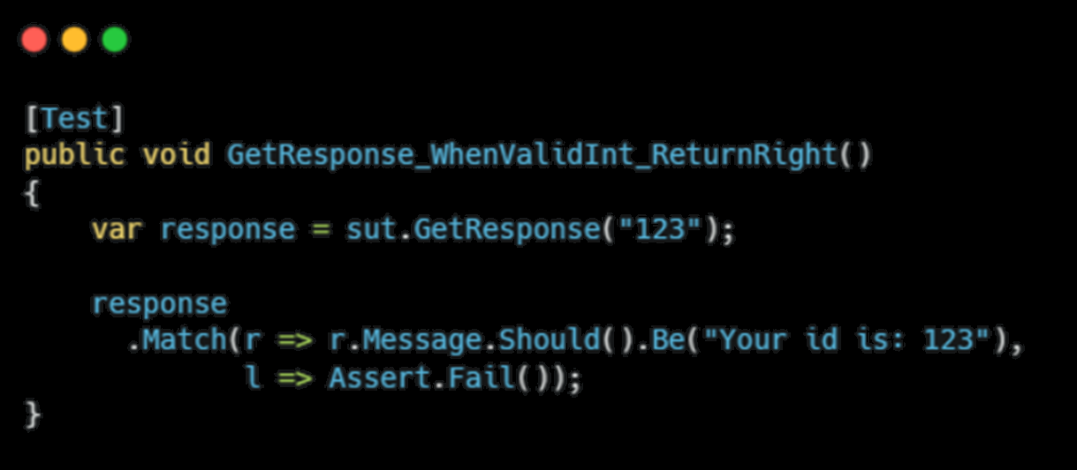
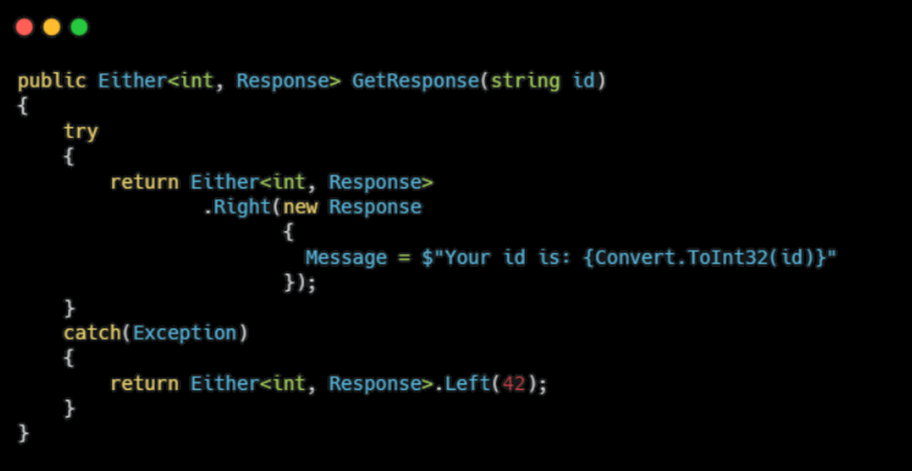
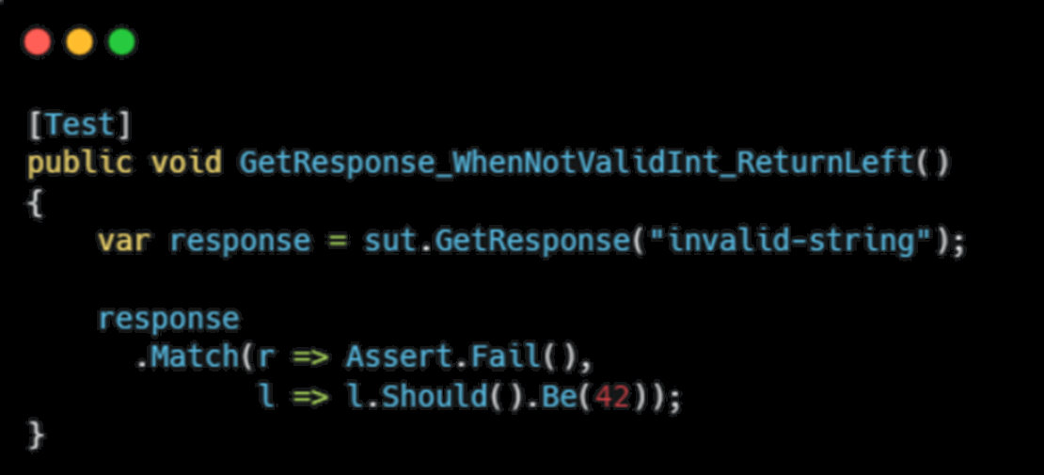
Move to functional
Either<L, R> … use case

Slide 25
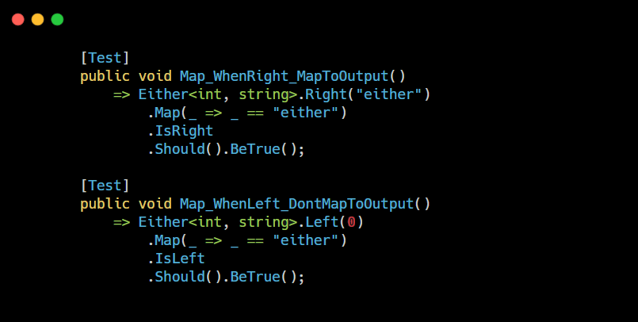
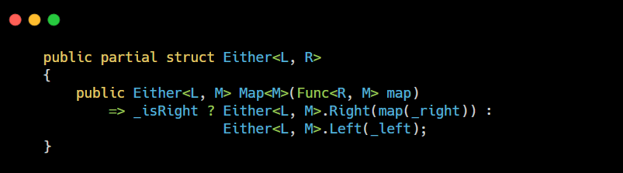
Move to functional
Either<L, R> … function concatenation Map

Slide 26
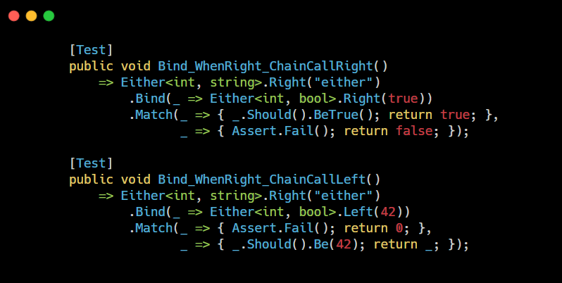
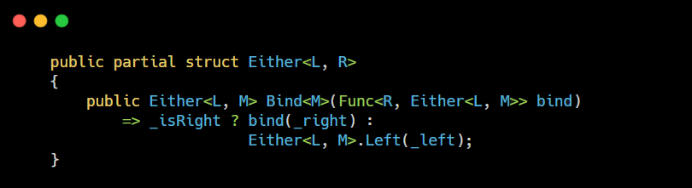
Move to functional
Either<L, R> … function concatenation Bind

Slide 27
Move to functional
Try monad
Try monad allow us to encapsulate into a function the exception handling
The Success value when the computation is ok without exception
The Exception value in case of exception

Slide 28
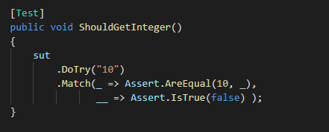
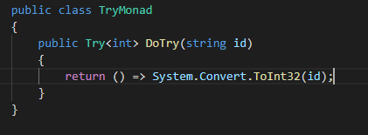
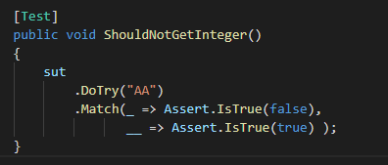
Move to functional
Try monad

Slide 29
Patterns
Functional programming

Slide 30
Move to functional
A lot of patterns…. ☺
OOD
Functional
Single Responsibility
Function
Open Closed Principle
Function
Interface Segregation Principle
Function
Factory Pattern
Function
Strategy Pattern
Function
Decorator Pattern
Function
Whatever….
Function

Slide 31
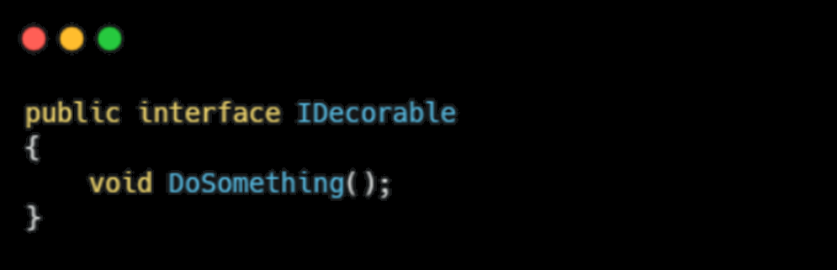
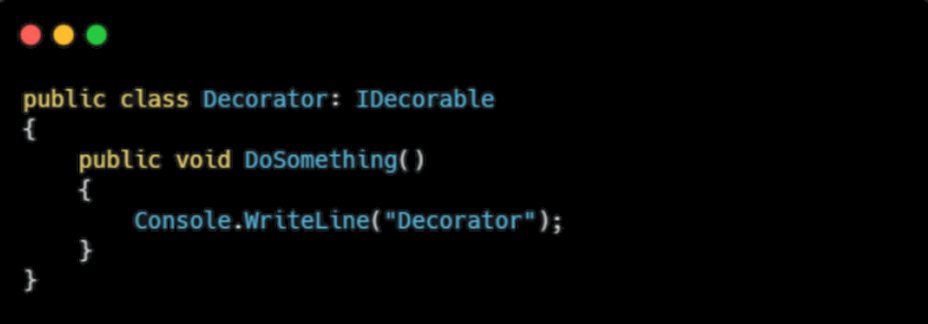
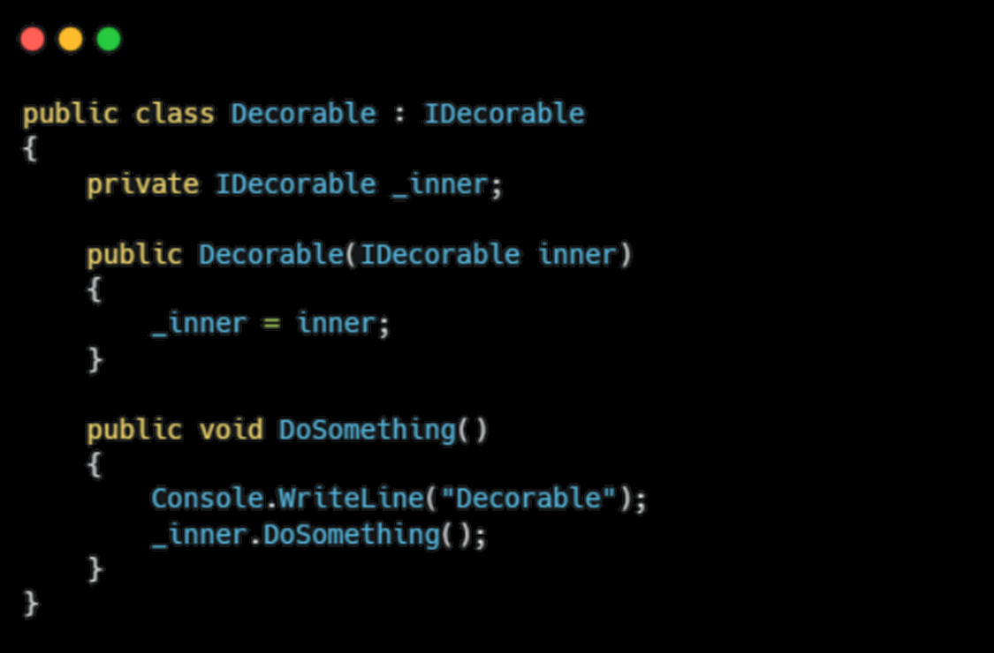
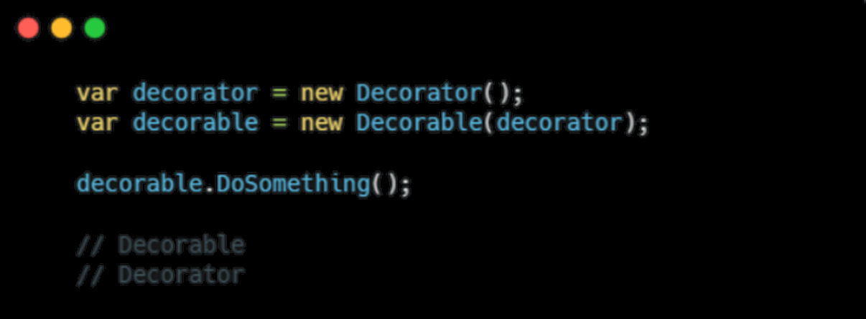
Move to functional
A lot of patterns…. Decorator

Slide 32
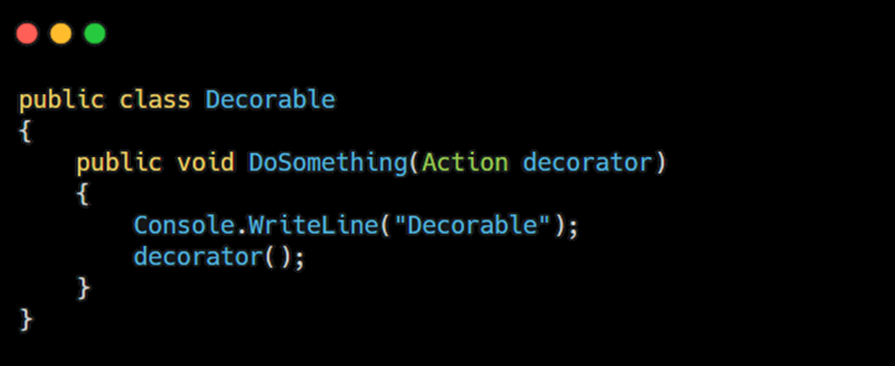
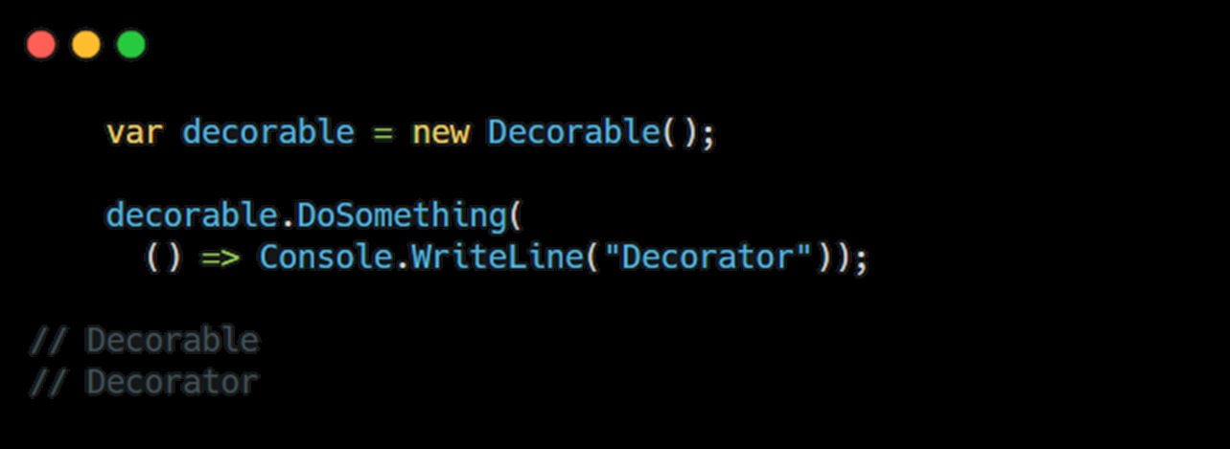
Move to functional
A lot of patterns…. Decorator using HOF

Slide 33
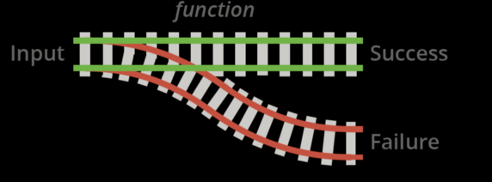
Move to functional
Railway pattern
Function is a block with an input and two possible outputs
We can compose functions to obtain a chain

Slide 34
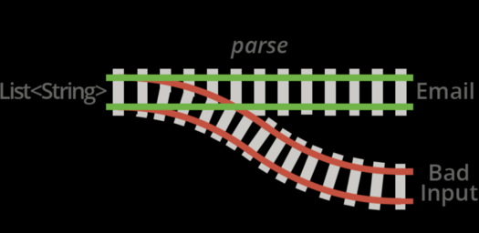
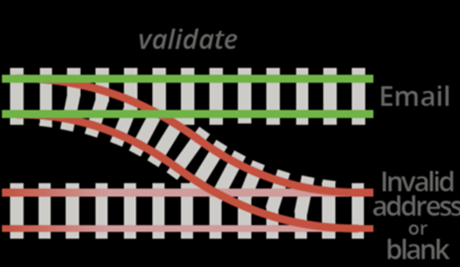
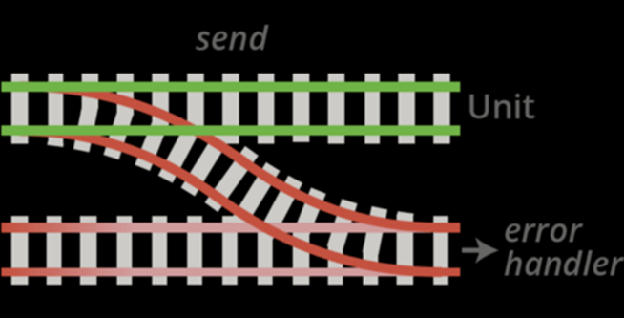
Move to functional
Railway pattern…use case
Sending email using a list of strings

Slide 35
Snippets
Functional programming

Slide 36

Move to functional
Snippets
Don’t reinvent the wheel
Using the library language-ext

Slide 37
Move to functional
Login validation
Validate a login form composed by email, password and code identification
Check if the mail address contains @
Check if the password length is gt 3
Check if the code is composed by digit only

Slide 38
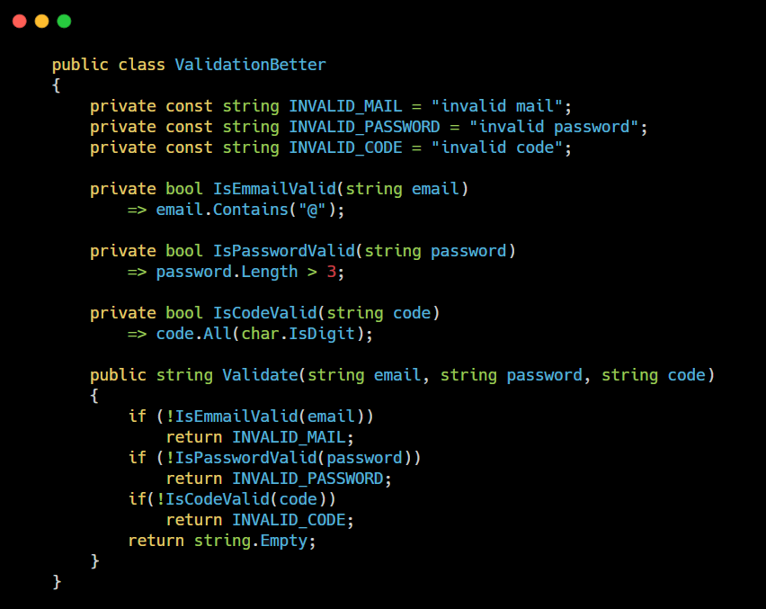
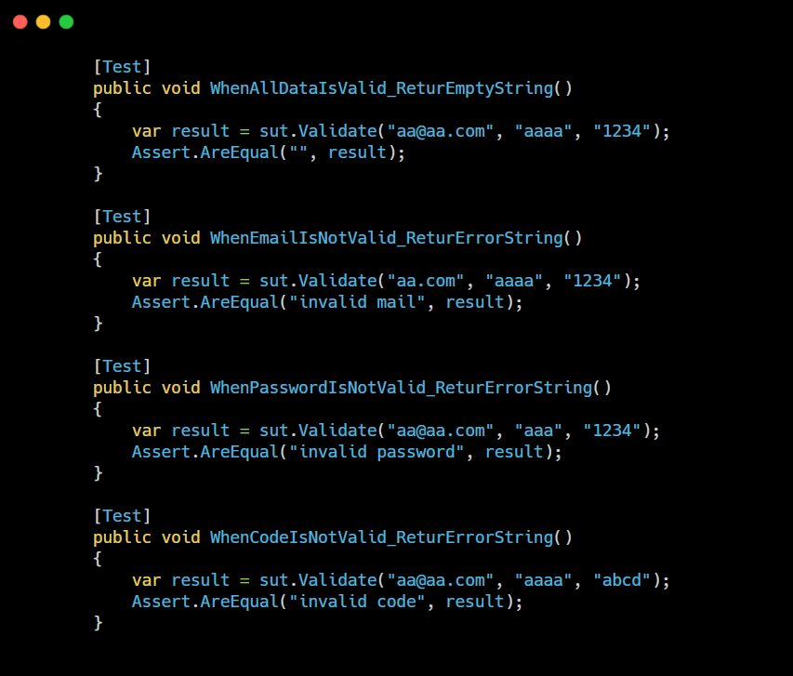
Move to functional
Validation … Basic way

Slide 39
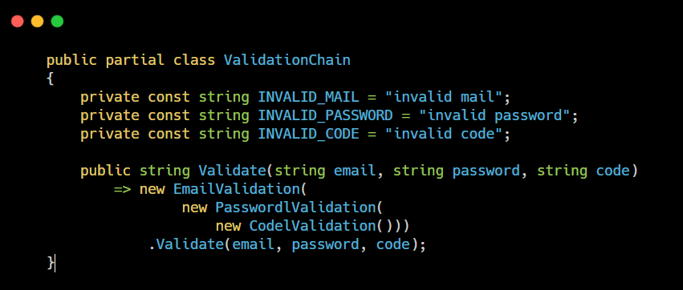
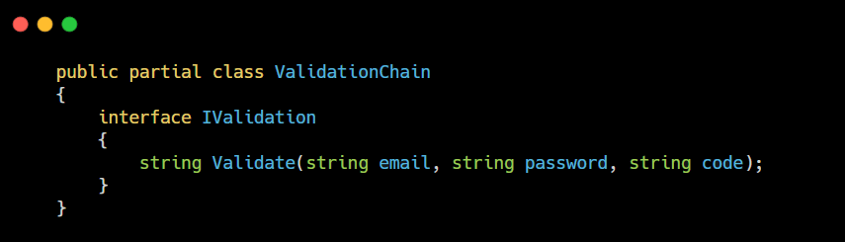
Move to functional
Validation … OOP way

Slide 40
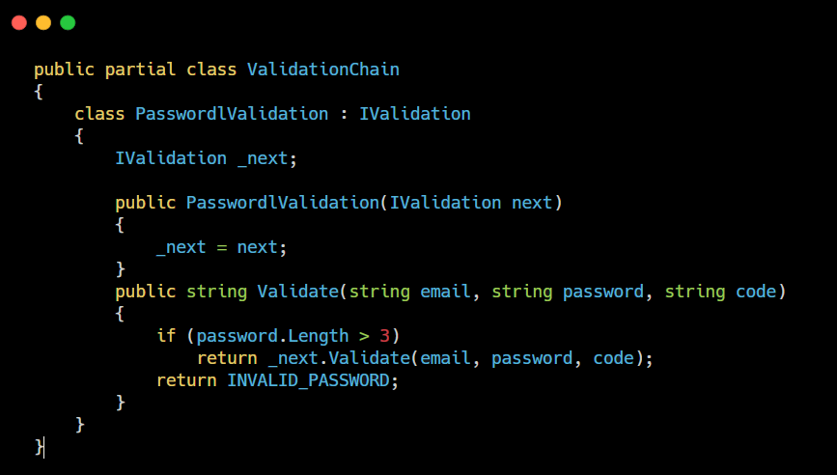
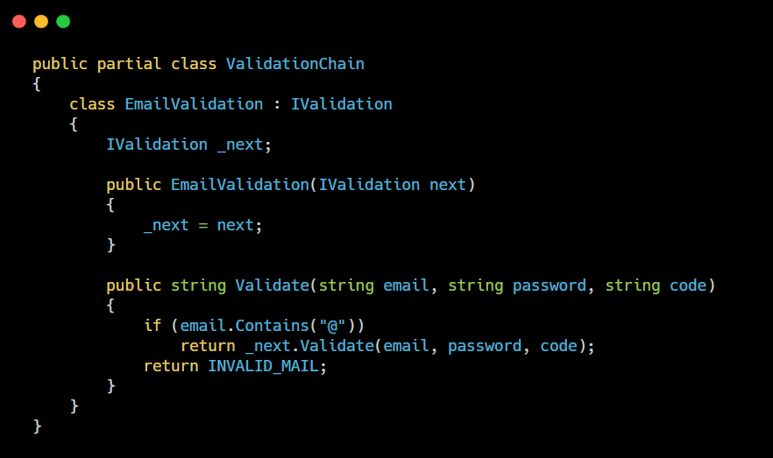
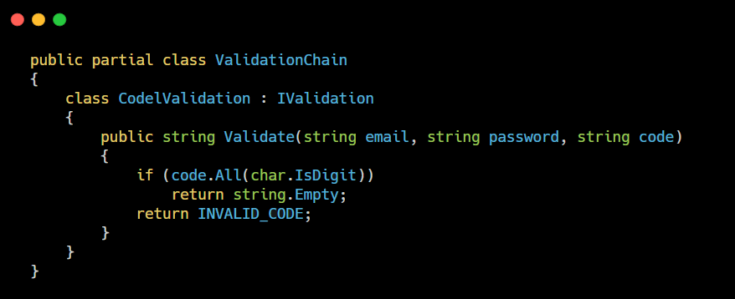
Move to functional
Validation … OOP way

Slide 41
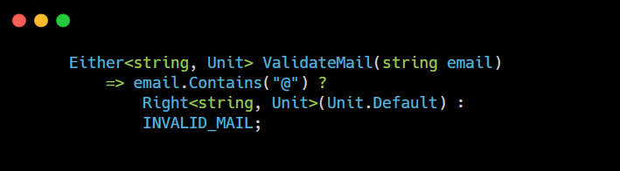
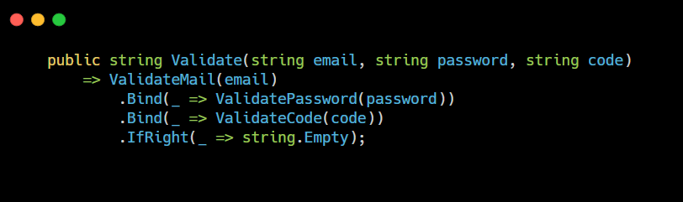
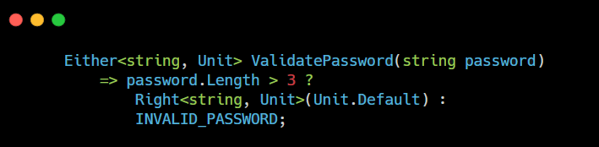
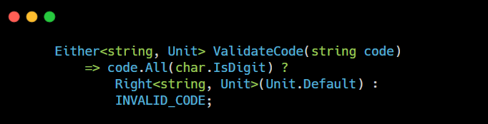

Move to functional
Validation … Functional approach

Slide 42
Move to functional
Chache, Get and Log
Check if a response is in the Cache
If not present Get form Api
Store in the cache
Log the action

Slide 43
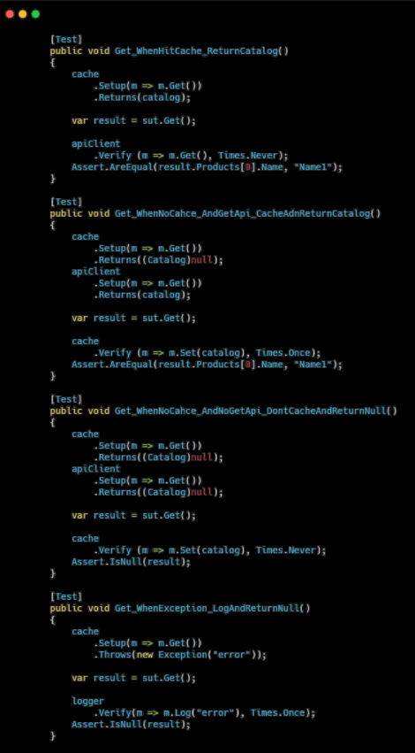
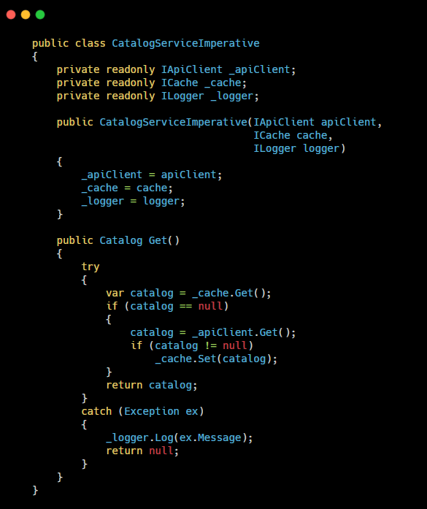

Move to functional
Chache, Get and Log…imperative

Slide 44


Move to functional
Chache, Get and Log…imperative

Slide 45


Move to functional
Chache, Get and Log…decoranting

Slide 46


Move to functional
Chache, Get and Log…decoranting

Slide 47


Move to functional
Chache, Get and Log…decoranting

Slide 48
Move to functional
Get, Get, Convert and Return
Get product list from Catalog Api
If no response return empty array
For each product Get product details from Product Api
If no response go to next product
Convert product detail into a view model
Return the array of product view

Slide 49


Move to functional
Get, Get, Convert and Return - IMPERATIVE

Slide 50



Move to functional
Get, Get, Convert and Return - IMPERATIVE

Slide 51


Move to functional
Get, Get, Convert and Return - FUNCTIONAL

Slide 52





Move to functional
Get, Get, Convert and Return - FUNCTIONAL

Slide 53
Move to functional
Resources
https://github.com/FrancoMelandri/spike-language-ext
https://github.com/louthy/language-ext
https://github.com/FrancoMelandri/tiny-fp
https://adit.io/posts/2013-04-17-functors,_applicatives,_and_monads_in_pictures.html
https://medium.com/javascript-scene/master-the-javascript-interview-what-is-functional-programming-7f218c68b3a0
https://medium.com/disney-streaming/option-either-state-and-io-imperative-programming-in-a-functional-world-8e176049af81
https://blog.codiceplastico.com/rop-csharp9

Slide 54
Thank you!

